Slide 1


A Comparative Study of Techniques for Addressing Class Imbalance in Machine Learning
Capt Brandon Hosley
The views expressed in this presentation are those of the author(s) and do not reflect the official policy or position of the United States Air Force, the Department of Defense, or the United States Government.

Slide 2
Overview
Motivation
Dataset
Methodology
Analysis
Results
Conclusion
Questions

Slide 3
Motivation of Research
Addressing class imbalance is a broad problem within ML
Many different techniques have been shown to be very effective
How do these perform under different imbalances?

Slide 4
Dataset - Summary
The principle data set is the diabetes dataset
Collected by CDC using BRFSS
Original dataset has 441,455
Kaggle set is 70,692
Balanced and Cleaned

Slide 5
Dataset - Exploration/Final Preparation
Correlation
Distribution
Asymmetry
Age
BMI
PhysHlth
Quantile Transform
Min-max Scale

Slide 6
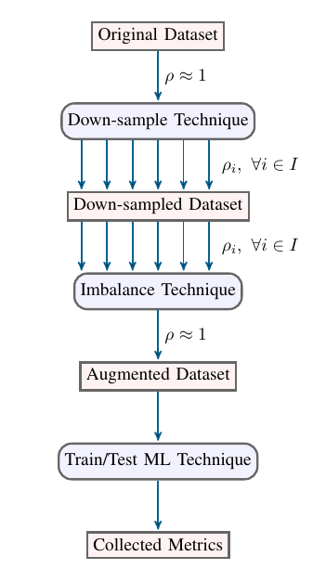
Methodology
Data set is clean
Induce Imbalance
Imbalance technique is applied
New set is evaluated by different classification techs
Classifier training functions provide equal access to limited flexibility in training (Grid searching)

Slide 7
Analysis
Each Trained Model
F1, Precision, and Recall
Hyperparameters
Operating time
Each Imbalance Technique
Collection of Model Stats
Thus, variance

Slide 8
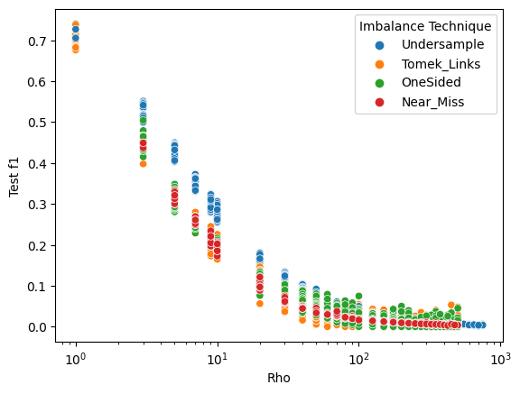
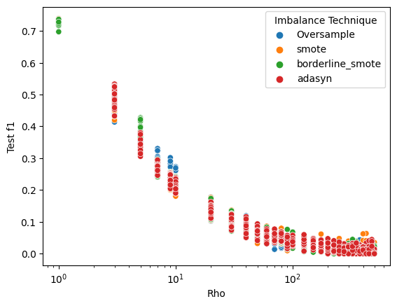
Results - Test F1
Undersampling Results - Test set
Oversampling Results - Test set

Slide 9
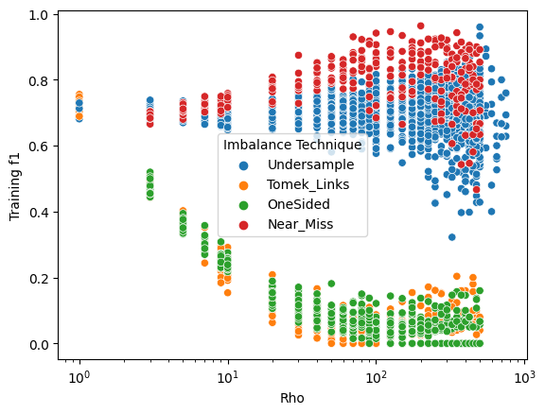
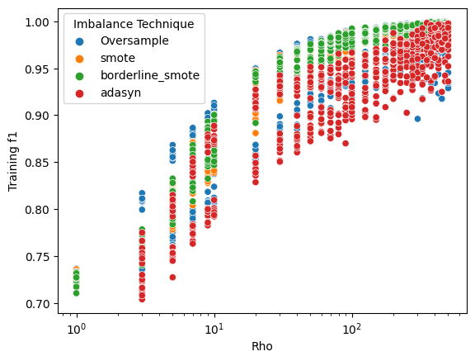
Results - Training F1
Undersampling Results - Training
Oversampling Results - Training

Slide 10
Conclusion - Future Work
Non-random downsampling
Use of datasets with different characteristics
Classification of >2 classes
Implement additional imbalance techniques
Implement additional ML techniques
Possible use as a base for future classes (CSCE 823)
Using Neural Network Classifiers
Using algorithm-level imbalance techniques

Slide 11
Questions
?

Slide 12
Citations

